Slide 1
Concussion: Return to Riding
Kenneth Perrine, Ph.D
Department of Neurological Surgery
Weill-Cornell Medical College

Slide 2
Topics
Traumatic Brain Injury
Concussion
ER and early treatment
Natural progression of concussion
Return to riding
Jockeys the LAST athletes to discuss and set voluntary or mandated guidelines for concussion
Junior high school soccer teams have more awareness and guidelines than jockeys

Slide 3
My Goals
Teach you about concussion
Discuss how to manage concussion, return to riding
I get it–
Little to no health insurance
Not under contract/salary– paid for each race
“Eat what you kill”– 1099 income
If you acknowledge concussion, you sit out races and lose money
But:
Make informed, rational decisions
Think of your future and that of your family

Slide 4
Concussion or Brain Injury?
Not all blows to the head are concussions
Are on a continuum
Concussion or Mild Traumatic Brain Injury (mTBI)
Moderate Traumatic Brain Injury
Severe Traumatic Brain Injury
Type of injury drastically affects outcome
Will discuss TBI (moderate or severe) first

Slide 5
Definition of TBI
Damage to brain tissue caused by mechanical force
All of the following:
Loss of consciousness
Retrograde Amnesia (amnesia for events before injury)
Post Traumatic Amnesia (amnesia for events after injury and after resumption of consciousness)
Skull fracture, facial fracture, brain contusions, bleeding in the brain or between the brain and skull, brain swelling
Objective neurological findings (e.g., weakness, deficits in pupil response or eye movements, etc.)
Objective findings on mental status examination (orientation to time, place, person; attention; memory; other cognitive skills)

Slide 6
Mechanisms of TBI
Mechanisms of brain injury:
Contact injuries: object strikes the head or head strikes object (falls)
Acceleration/deceleration injuries: movement of the brain within the skull. E.g., car accidents with air bag deployed
Open TBI: object penetrates brain (bullet, shrapnel, etc.)
Injuries can be focal (affecting just one region of the brain) or diffuse (affecting the brain in a widespread pattern)
Result can be mTBI or moderate/severe TBI

Slide 7
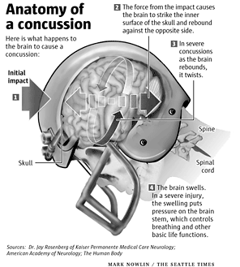

Slide 8
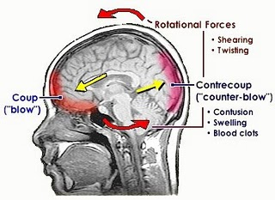

Slide 9
Classification of TBI Severity
Glasgow Coma Scale (GCS) immediately after injury
Best motor response
Best verbal response
Best eye response
Duration of true loss of consciousness
Duration of post traumatic amnesia (PTA): time between resumption of consciousness and laying down new memories (e.g., awake and talking in ER but no recollection of it later)

Slide 10
Findings Following Moderate/Severe TBI
Skull fractures
Displaced
Depressed into brain
Leakage of cerebral spinal fluid from nose or ears
Contusions (bruising) of brain
Hematoma (bleeding) in brain
Subdural hematoma (slow venous bleeding)
Epidural hematoma (rapid arterial bleeding)
Diffuse axonal injury (DAI- tearing/shearing of the long fibers leading down from the cortical grey matter

Slide 11
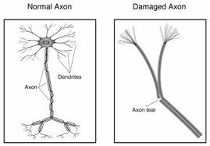
Neuron and Axon

Slide 12
Course of Recovery from Severe TBI
Coma
Vegetative State
Minimally Conscious State
Confused State
PTA
Recovery

Slide 13
Functional Outcomes
Return to work and independent living
Injury severity is predictive of functional outcomes
Duration of PTA is best predictor of outcome
Pre-injury factors are also predictive of functional outcomes

Slide 14
Outcomes Following Moderate/Severe TBI

Slide 15
Implications for Jockeys Recovering from Moderate/Severe TBI
“Good Recovery” (~50%) usually takes 3-4 years, and is helped by treatment in a specialized rehab facility
Still a risk of greater injury with less severe impact (more
likely to sustain another skull fracture or concussion)
“Moderate Disability” usually results in ability to function in another job but with residual cognitive deficits (especially memory) and struggles to succeed at work as well as personality problems (frustration tolerance, anger outbursts, impulsivity, etc.)
“Severe Disability” usually means an inability to work at any job and with significant psychosocial problems
Return to Riding should NOT be considered after a moderate or severe TBI:
High risk of sustaining a severe TBI resulting in death or permanent
disability

Slide 16
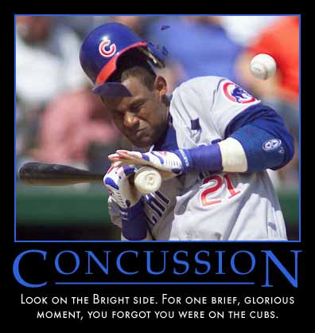

Slide 17
Concussion
Less severe form of TBI (mTBI)
Does not result in structural brain damage on CT/MRI
Damage is neurochemical, not to brain substance
Usually resolves without any lasting problems

Slide 18
Definition of Concussion (4th Zurich Conference
Direct blow to the head, face, neck or elsewhere with an‘impulsive’ force transmitted to the head. Rapid onset of short-lived neurological impairment that resolves spontaneously. Sometimes, symptoms and signs may evolve over minutes to hours.
May result in neuropathological changes, but acute symptoms reflect a functional disturbance rather than structural– usually normal neuroimaging studies
May or may not involve loss of consciousness. Resolution of the symptoms typically follows a sequential course. However, in some cases symptoms may be prolonged.

Slide 19
Other Aspects of Concussion
Do NOT need to have LOC– most have at most brief LOC
“Bell rung” “Ding” “Seeing Stars”
may or may not be concussions
Retrograde Amnesia usually brief
Post-traumatic Amnesia (PTA) can be extensive (remembering only ER)
Many Post-Concussion Symptoms (PCS)

Slide 20
Post-Concussion Symptoms
Physical | Cognitive | Emotional | Sleep
Headache | Feels mentally “foggy” | Irritability | Drowsiness
Nausea/Vomiting | Poor concentration | Sadness | Onset insomnia
Balance problems | Poor memory | Nervous/Anxious | Sleeping less than usual
Visual problems | Slow responses | More emotional | Sleeping more than usual
Fatigue | Repeats questions
Sensitivity to light/noise | Confused about recent events
Looks “dazed”

Slide 21
Concussion Modifiers (Zurich)
Prolonged (>1 min.) LOC, amnesia
Number, severity, duration of symptoms
Recent concussion(s)
Concussion from less impact than prior concussion
Co-morbidities of migraine or mental health disorders, ADHD, learning disabilities, sleep disorders
Use of psychoactive drugs or anti-coagulants
Dangerous sport, high-risk activity (falling off of a horse galloping at 40-50mph and being trampled)

Slide 22
Concussion in Riding
“It’s not a matter of IF I have another concussion, it’s a matter of WHEN I do”
More concussions than in ANY other sport
Not the repeated sub-concussive blows of boxing, football or hockey, but very severe when occurs
Collision with ground, your own horse, other horses
Better helmets alone are not the answer but do help

Slide 23
Immediate Management: Ideal but Recognizing Realities of Riding
SPORT
Remove from riding
Sideline assessment with SCAT-3 by physician or other licensed healthcare provider
SPORT OR NON-SPORT
Follow CDC guidelines
Return too quickly can result in concussion from less impact
Try NOT to ride again that program if symptomatic

Slide 24
Transport to ER
By ambulance if:
Suspected spinal cord involvement
Focal neurologic deficit (paralyzed/weak, sensory loss, speech)
Condition worsens (subjective symptomss, nausea, vomiting, balance, fatigue, decline in mental status)
“Raccoon eyes”, bruising behind ear
Bleeding from nose or ear
Seizure/convulsion
If don’t transport, alert caretaker and give CDC fact sheet on what to watch out for after concussion

Slide 25
When to DEMAND CT
New Orleans Criteria: GCS = 15 | Canadian Rule: GCS = 13 - 15
Headache | GCS < 15 within 2 hr after injury
Vomiting | Suspected open/depressed skull fx
Age > 60 | Any sign of basal skull fracture (otorrhea, rhinorrhea, raccoon eyes, Battle’s sign)
Drug/alcohol intoxication | >=2 episodes of vomiting
Persistent anterograde amnesia | Age > 65
Soft-tissue or bone injury above clavicle | Retrograde Amnesia >= 30 minutes
Seizure | “Dangerous mechanism” (MVA vs. pedestrian, ejection from vehicle, fall from > 3 feet)

Slide 26
After Concussion
Not left alone, go to hospital if any of following
Headache that WORSENS
Drowsy and cannot be woken up
Can’t recognize people or places
Repeated vomiting
Confusion/irritability worsens
Seizures
Weakness/paralysis, numbness
Unsteady on feet
Slurred speech

Slide 27
First Few Days
Rest & avoid strenuous activity if symptoms worsen
No alcohol/recreational drugs
No sleeping medication (can mask bleeding in brain)
Avoid aspirin or NSAIDs for headache– can mask
Avoid driving if possible until symptoms improve
NO exercise or riding until symptoms improve

Slide 28
Recovery
Most uncomplicated concussions resolve in 1-2 weeks
If more than a few symptoms, or some severe, consider evaluation at a concussion clinic
COMPLETE cognitive and physical rest is no longer considered appropriate
Tailor rest to symptoms– if activity produces/exacerbates symptoms, back off
As recovery progresses, increase activity

Slide 29
Natural Progression of Uncomplicated Concussion
Gradual resolution of symptoms over 2-4 weeks, complete usually by 3 months
Some football/hockey players can play in 1 week
Most patients recover fully
“Miserable Minority” take longer with persisting symptoms
Longer recovery if prior concussions

Slide 30
NFL and NHL Protocol
NHL: ImPACT computerized battery at baseline
After concussion:
Wait until mostly symptom free
Repeat ImPACT and get brief neurocognitive testing
NFL: Same as above, except baseline neurocognitive testing
Both: If pass ImPACT and neurocognitive testing
Gradually escalating exercise
Move on only if asymptomatic at each step
Exercise
Light exercise (walking, riding exercise bike)
Running, interval bike sprints, vigorous exercise
Non-contact drills in full equipment; lifting (riding horse, not racing)
Limited, controlled return to full practice (riding: practice racing)
Return to racing

Slide 31
When to Refer for Neurocognitive Testing
PCS symptoms are not getting better
History of multiple prior concussions
Positive findings on neuroimaging, neurologic examination
Suspicion of non-sports related factors

Slide 32
Neuropsychological Evaluations
Should be brief and targeted to concussion signs and symptoms– actual testing < 1 hour
Computerized testing MAY be helpful, especially if there is a VALID baseline
Paper-and-Pencil, face-to-face testing more valid
Recommendations should make sense, and not include “snake-oil” invalid tests
www.quackwatch.com

Slide 33
Utilizing a Neuropsychologist
Pro:
Can monitor effort, reliability
Look in their eyes
Non-sports related issues– family, financial
Flexibility to target specific symptom complexes
Sensitivity/specificity of neurocognitive tests
Con:
Cost
Availability

Slide 34
Computerized Batteries
Reliability is very poor
Confusion over instructions
Wrong buttons
Accidentally moving screen to screen
No way to monitor effort
“Sandbagging” at baseline (intentional poor effort)
Computer glitches– screen savers, backups
No measure of delayed recall memory

Slide 35
ImPACT Battery
6 subtests and a symptom checklist
Combined to form composites:
Verbal Memory
Visual Memory
Visual Motor
Reaction Time
Impulse Control
Norms and Reliable Change Indexes
Studies by researchers not affiliated with ImPACT show very poor reliability

Slide 36
My Paper-and-Pencil Battery: <30 $200-$300
Post-Concussion Scale (21 signs/symptoms)
Verbal learning
Non-verbal learning
Visuo-motor sequencing/speed
Visuo-motor learning
Attention/concentration
Fine motor speed
Frontal executive/cognitive speed
Balance Errors Scoring System (BESS)
Review of ImPACT computerized battery and SCAT-3

Slide 37
Memory: List Learning
Read & Recall 3 Times, ½ hour delay:
Fork
Rum
F
Pan
Pistol
Sword
Spatula
Bourbon
Vodka
Pot
Bomb
Rifle
Wine

Slide 38
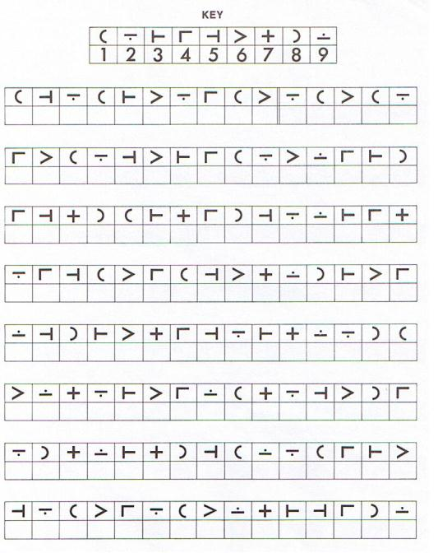

Slide 39
Case Example: NY Jet
Concussed during play, not noticed at first
Continued to play (defense)
Other players alerted ATC’s
Pulled, failed SCAT-2
Had to hide his helmet to keep him from returning to play

Slide 40
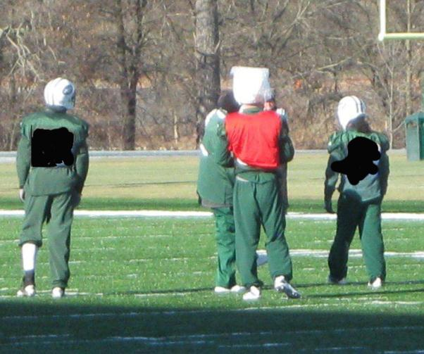
Day after Neuropsych Assessment at Practice (Red Jersey)

Slide 41
Progression of Player
Passed ImPACT testing with scores > 90%ile
Neurologist cleared to play but I was suspicious due to paper-pencil testing and interview
Referred to Cornell neurologist who found cerebellar deficits
MRI/DTI showed Diffuse Axonal Injury
Previous year I had returned him too early

Slide 42
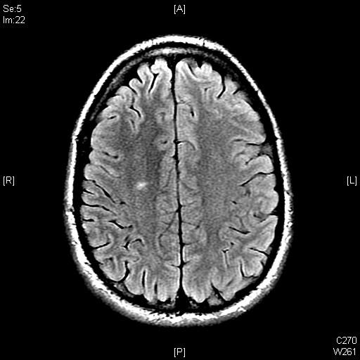
DAI on MRI

Slide 43
Controversies
Media hype exceeds science and facts, especially:
NY Times
ESPN
Sports Illustrated
Concussions ARE problem, but writers are out for prizes and fame
Front page NYT article on concussions by Alan Schwarz was full of errors (I saw the player he highlighted). I wrote a letter to the editor of NYT correcting errors, not published. Schwarz won a Pulitzer Prize for the article.
Don’t believe everything you read, ANYWHERE!

Slide 44
Conclusions
Moderate to severe traumatic brain injuries usually result in inability to continue riding
Concussions are different. Depends on:
Number of concussions
Severity of concussions
Allowing proper time to recovery
Try to seek expert opinion– concussion specialist
Get neuroimaging (MRI preferable over CT)
Get brief neurocognitive testing, including post-injury ImPACT computer and paper/pencil testing

Slide 45
Conclusions
There is a difference between concussion and TBI
Do NOT try to hide concussion symptoms
Money made on rest of one day’s racing program is not worth what could happen next
One concussion makes you more likely to have a second concussion with LESS impact if you have not cleared from the first concussion
There is no “magic number” of number of concussions that is “too much”
Think about your family and how you will be at 65yo

Slide 46
My Contact Information
Kenneth Perrine, Ph.D.
NY Presbyterian/Weill-Cornell Medical Center
krp2003@med.cornell.edu
(212) 746-2197
Feel free to call with any questions about yourself
Agencies/Groups: please contact me for establishing guidelines, etc.
I will distribute a list of neuropsychologists who are experienced in assessing concussion without ripping you off

